Slide 1


Hotel Management Project In Spring Boot with Hibernate and Angular
M.Monisha
2021-6312
EBEON1121484231

Slide 2
Introduction
Hotel Management System is a java web application project that is an online platform for customers to book online hotel rooms.
It will help you, the hotel owner, to manage their customer details that will save time and money. let’s understand all the functionality and user role for the hotel management project.
The main functionality of the hotel management system is to search hotels. user can book a hotel. user can maintain a history of the records as well. user can cancel a booking. As an admin user can manage all the activities performed by the user end.

Slide 3
Technologies Used
Spring Boot 2.2.6+
Maven 3.2+
Spring Boot Framework 5.1.4
Java 8
MySql
Nodejs
Angularjs
Spring Data JPA(Hibernate)

Slide 4


Angular + spring boot crud full stack
View Templates
Components
Services
HTTP Client
Spring Rest Controller
Spring Data JPA
MySQL

Slide 5
Project Requirements
We create a web application for Hotel Management System,
User should be able to :
Get all booking Details
Book A room
Update a details
Cancel A room
And also includes the following pages:
About us
Services
Contact us
Gallery

Slide 6
Crud Operation
Update Module:
It enables admin to add and edit customers records.
01
Delete Module:
This module is created to delete any details.
02
Fetch module:
It enables to view all status & customers records easily.
03
Add Modules:
It enables admin to add customer or book a room.
04

Slide 7
APPLICATION ARCHITECTURE
Front-End
Angular
Back-End
MySQL Workbench
DataBase
Hotel Controller
Hotel Repository
Hotel Service
Nodejs
VSCODE
SPRINGBOOT

Slide 8
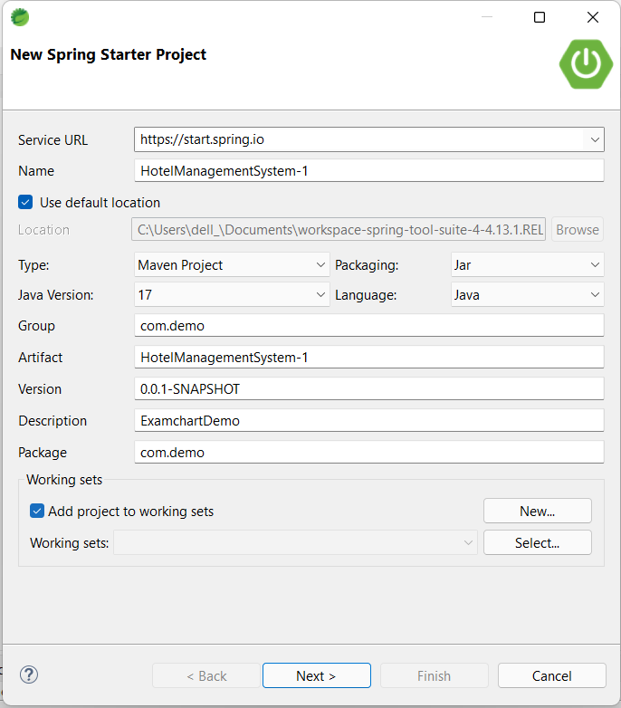
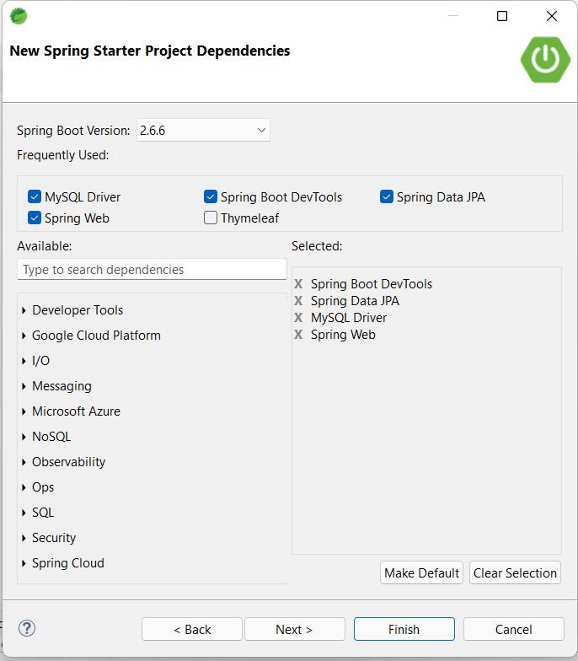
Creating Spring Boot Project

Slide 9
APPLICATION PROPERTIES
server.port=9091
spring.datasource.driver-class-name=com.mysql.cj.jdbc.Driver
spring.datasource.url=jdbc:mysql://localhost:3306/hotel
spring.datasource.username=root
spring.datasource.password=*****
spring.jpa.show-sql=true
spring.jpa.hibernate.ddl-auto=update
spring.jpa.database-platform=org.hibernate.dialect.MySQL8Dialect
spring.jpa.properties.hibernate.dialect.storage_engine=innodb
logging.level.org.hibernate.SQL=DEBUG
logging.level.org.hibernate.type=TRACE

Slide 10
Creating an Angular Project
Creating An Angular project in VSCODE by using this Command - “ng new HotelManagement”.
So what we will add in angular app,
Components:
Add-Component
Fetch-Component
Delete-Component
Update-Component
About-Component
Contact-Component
Gallery-Component
Home-Component
Services-Component
Command used to create Components : ” ng g c componentname ”
Service :
Hotel.service
Command used to create Service : ” ng g s servicename ”

Slide 11
Angular app component diagram
Create Add Component
Create Update Component
Create Delete Component
Create Fetch Component
Router
APP
Hotel Service
HTTP Client

Slide 12
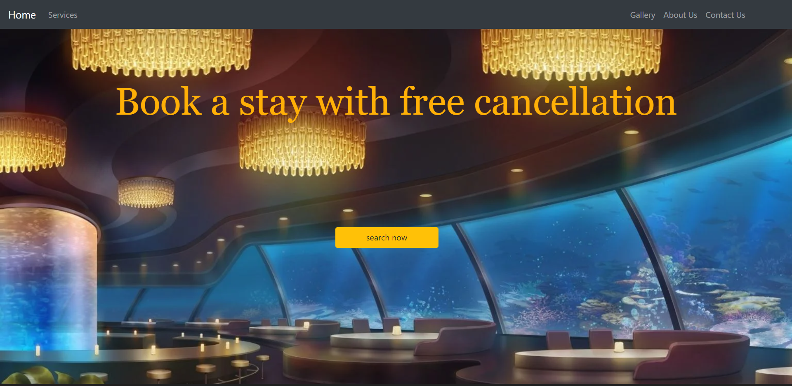
HOME PAGE

Slide 13

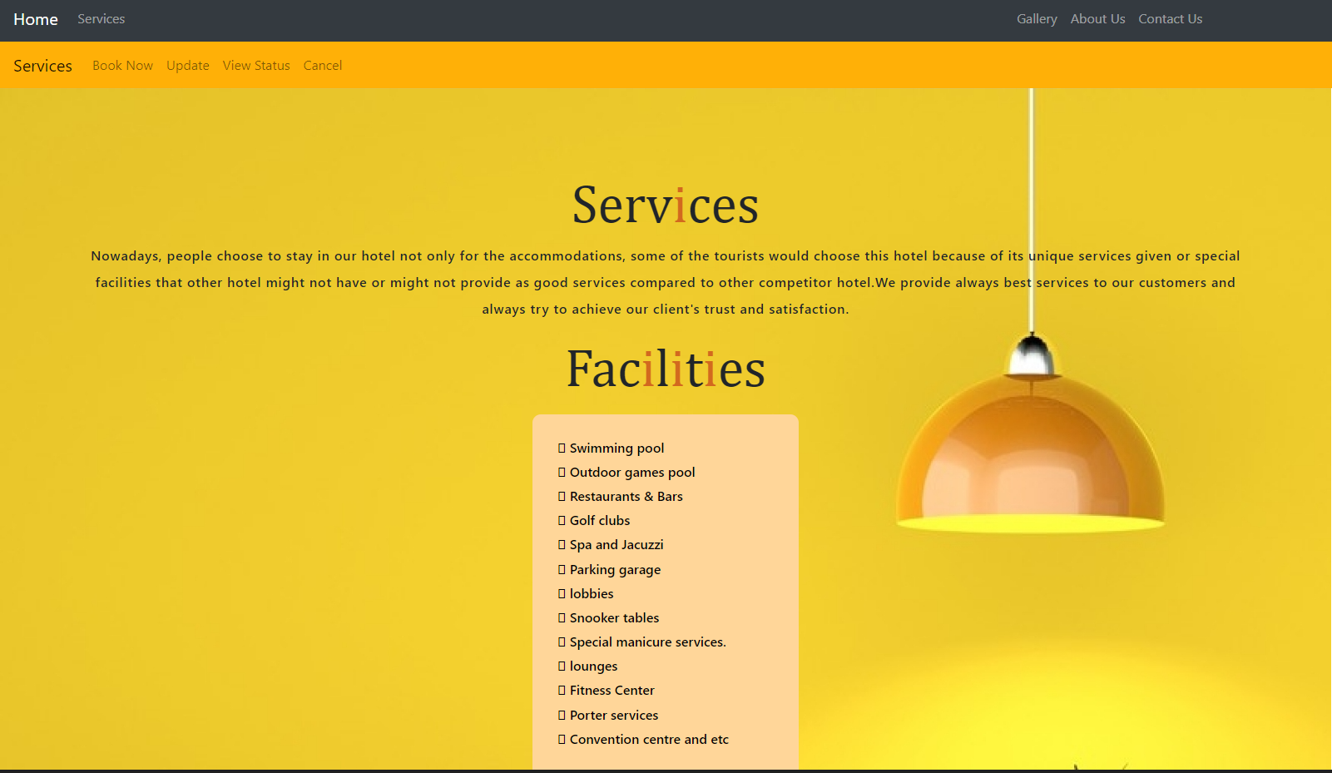
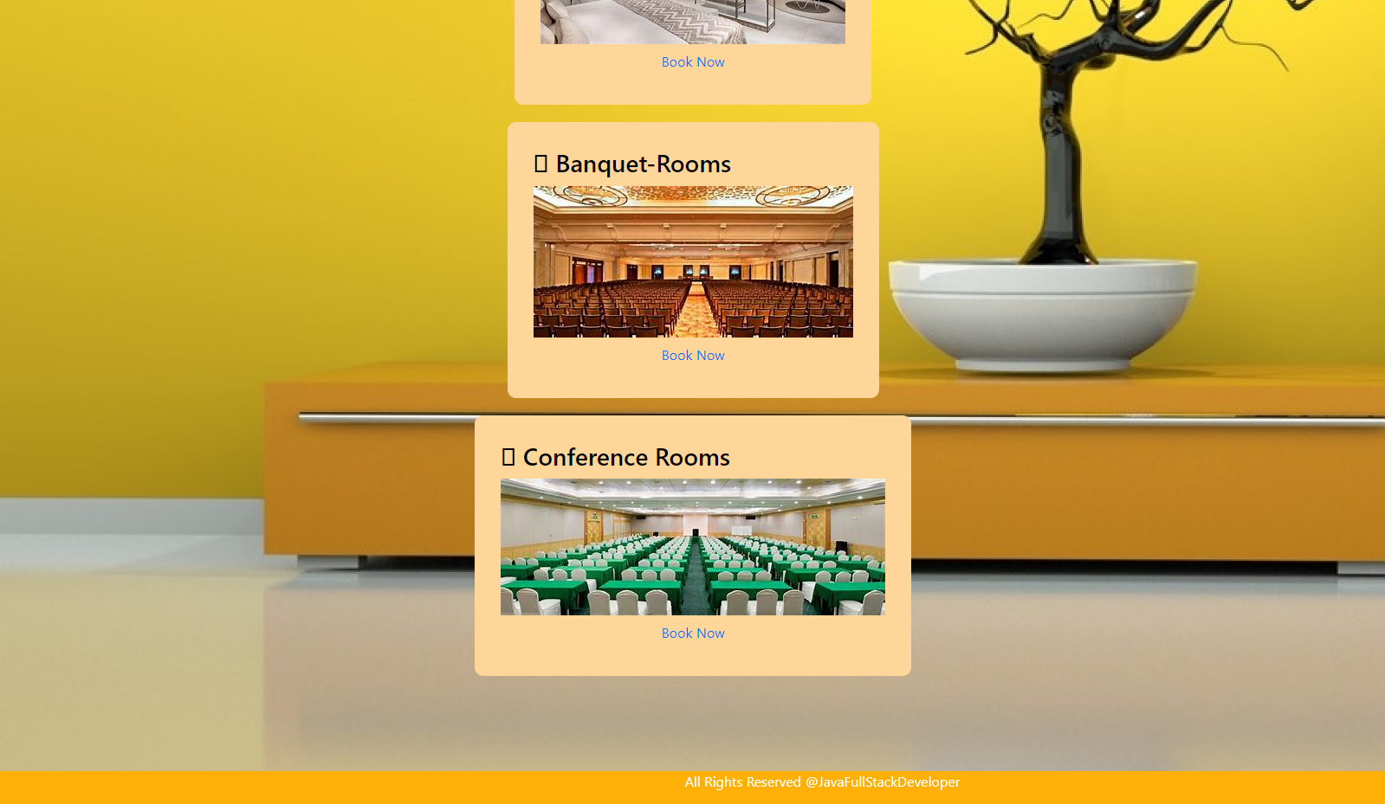
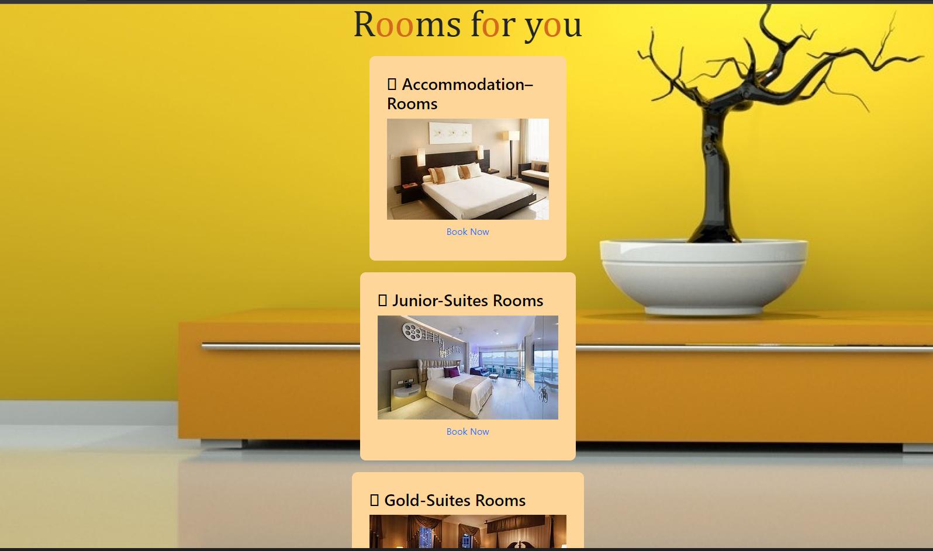
SERVICES PAGE

Slide 14
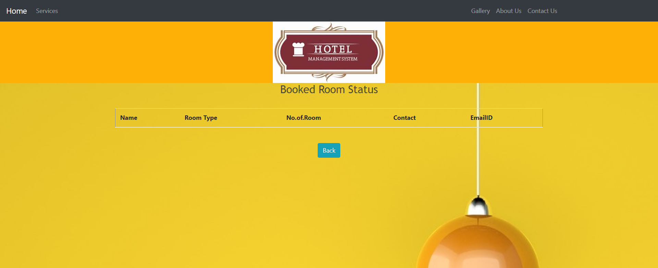
View STATUS PAGE

Slide 15
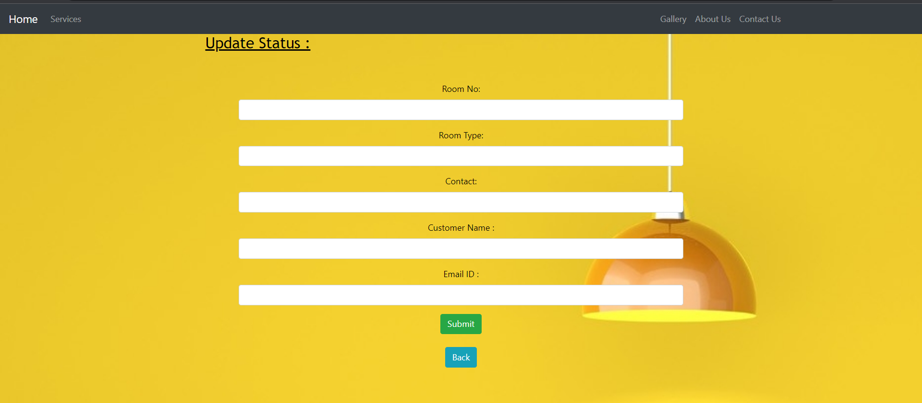
UPDATE PAGE

Slide 16
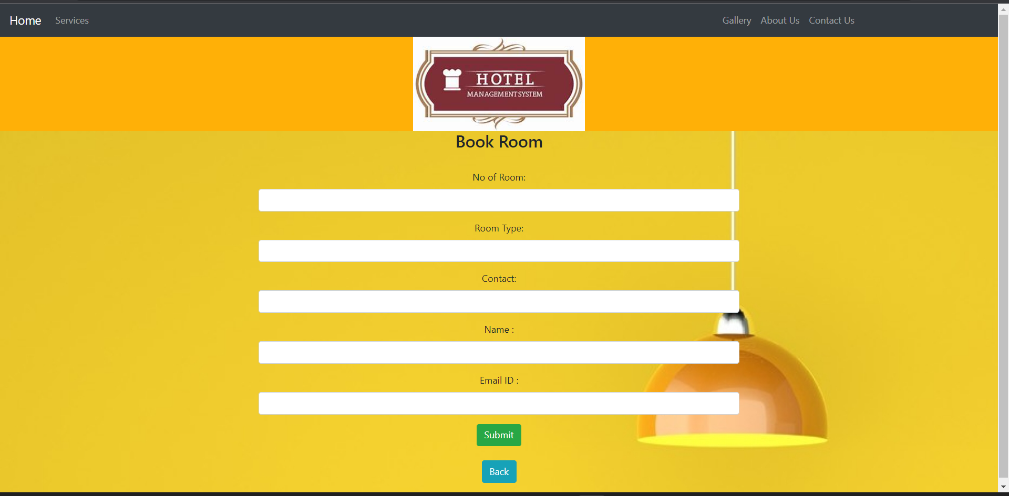
BOOK NOW PAGE

Slide 17
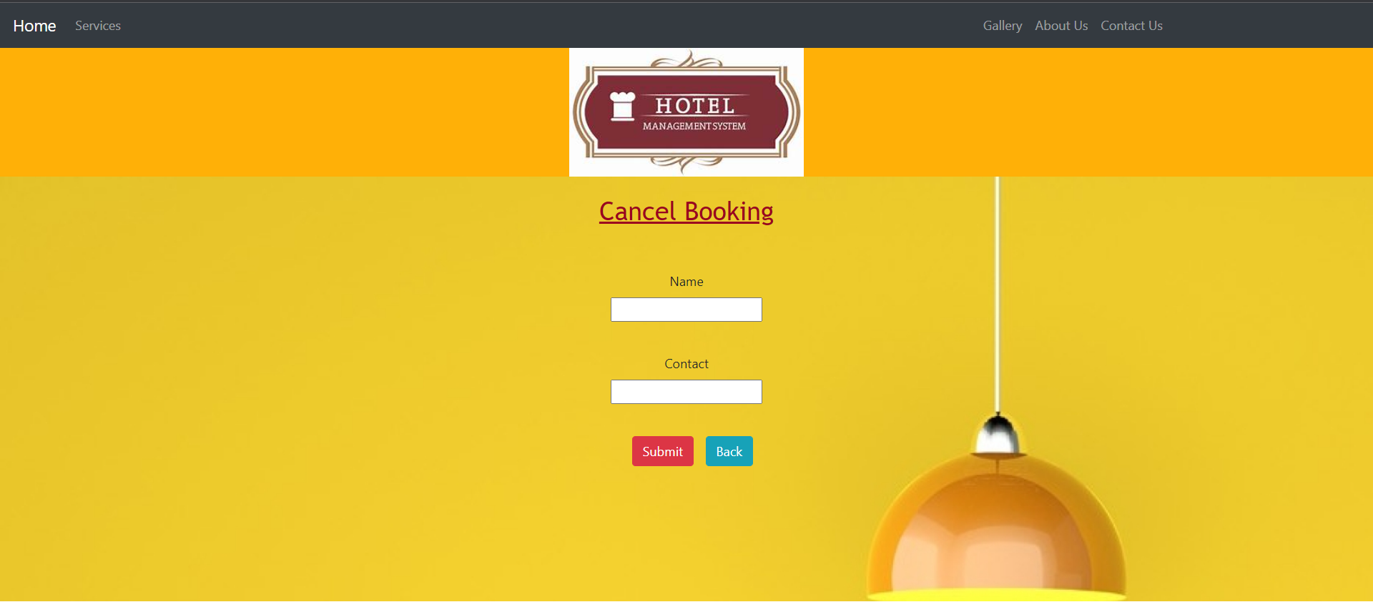
CANCEL ROOM

Slide 18
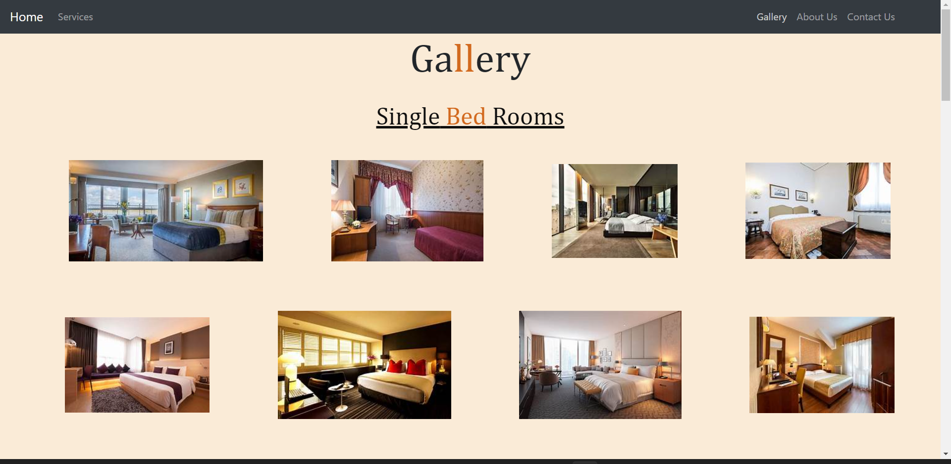
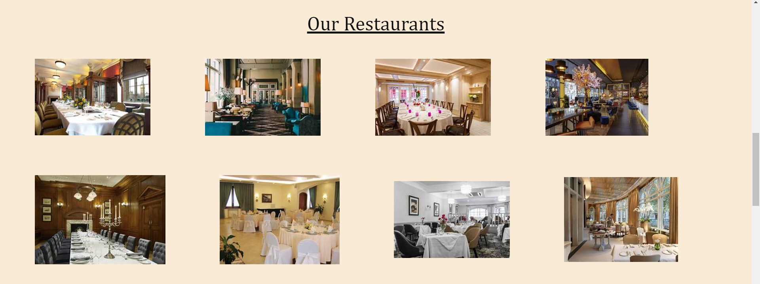
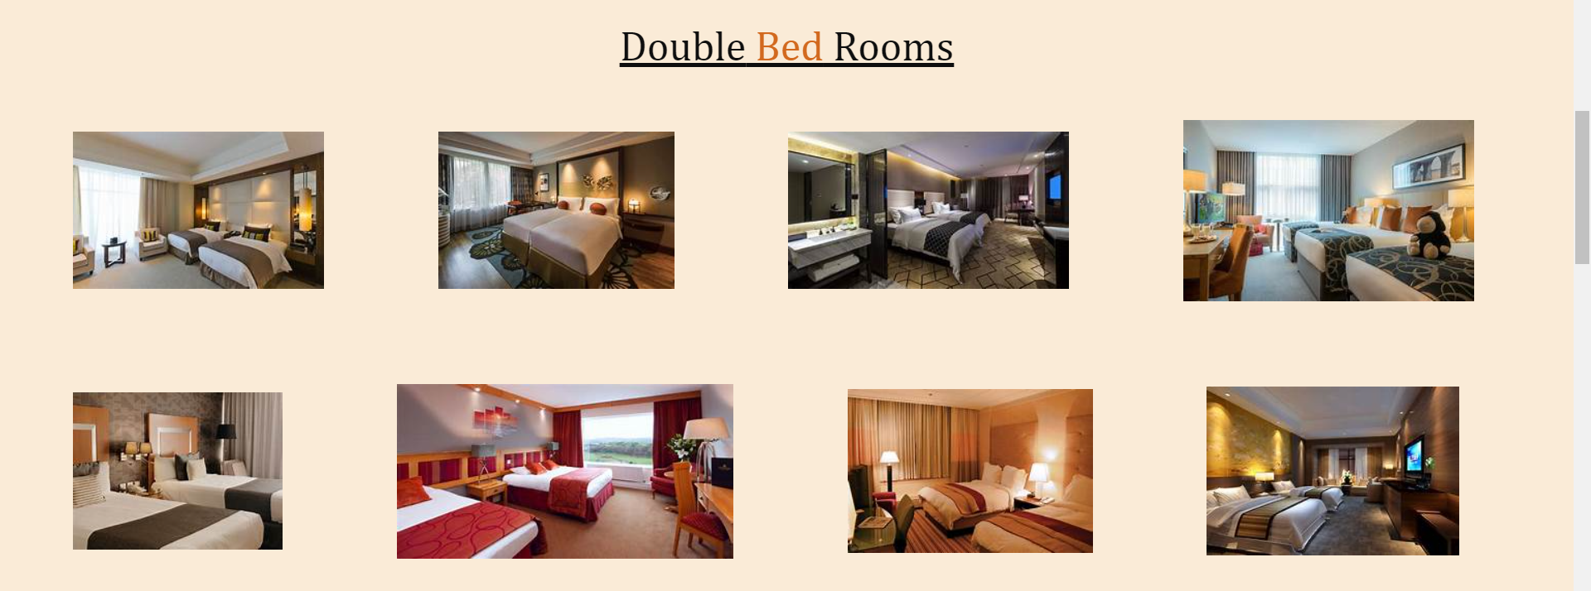
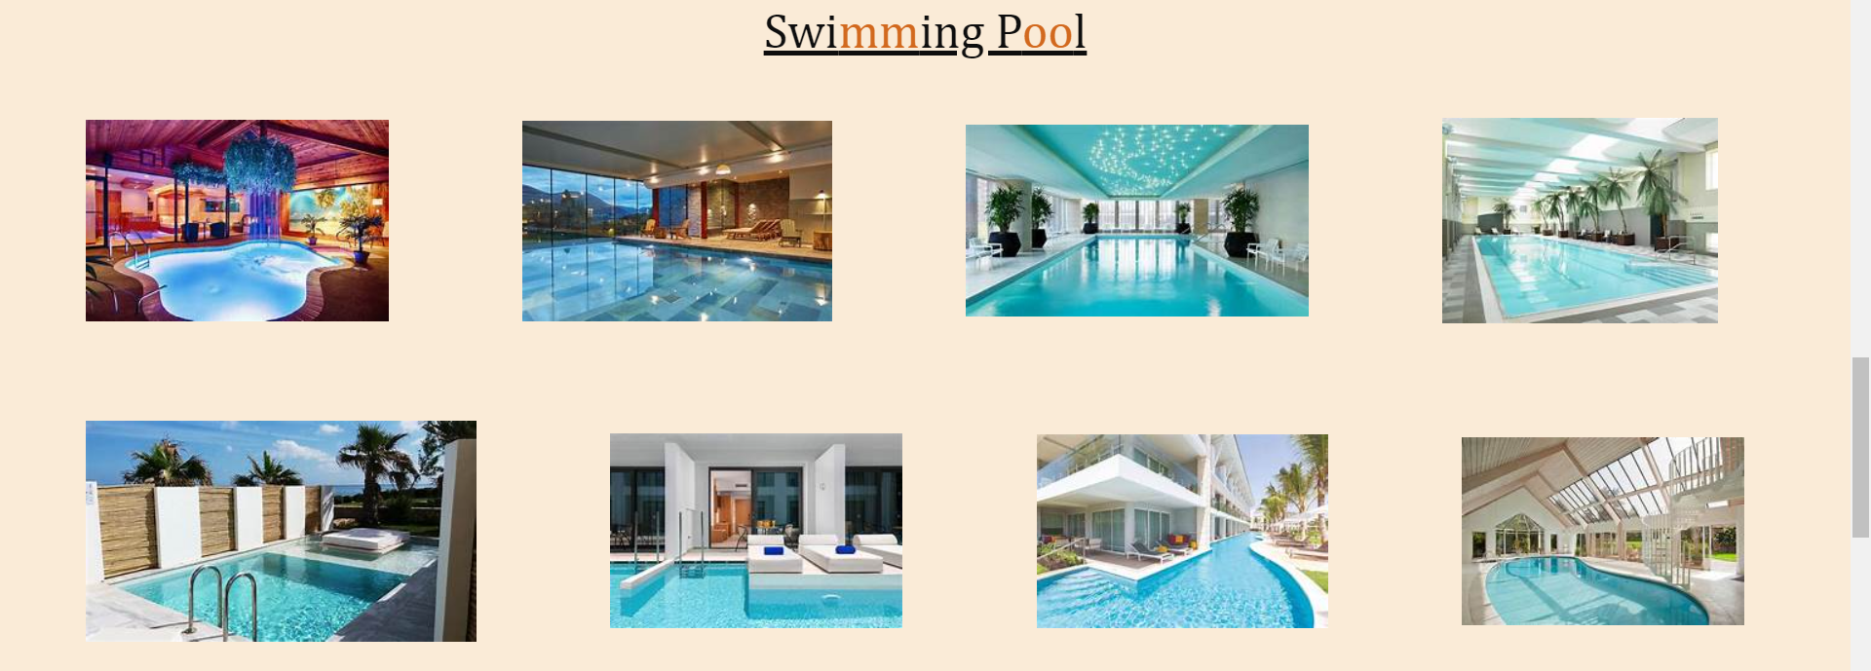
GALLERY

Slide 19


GALLERY

Slide 20
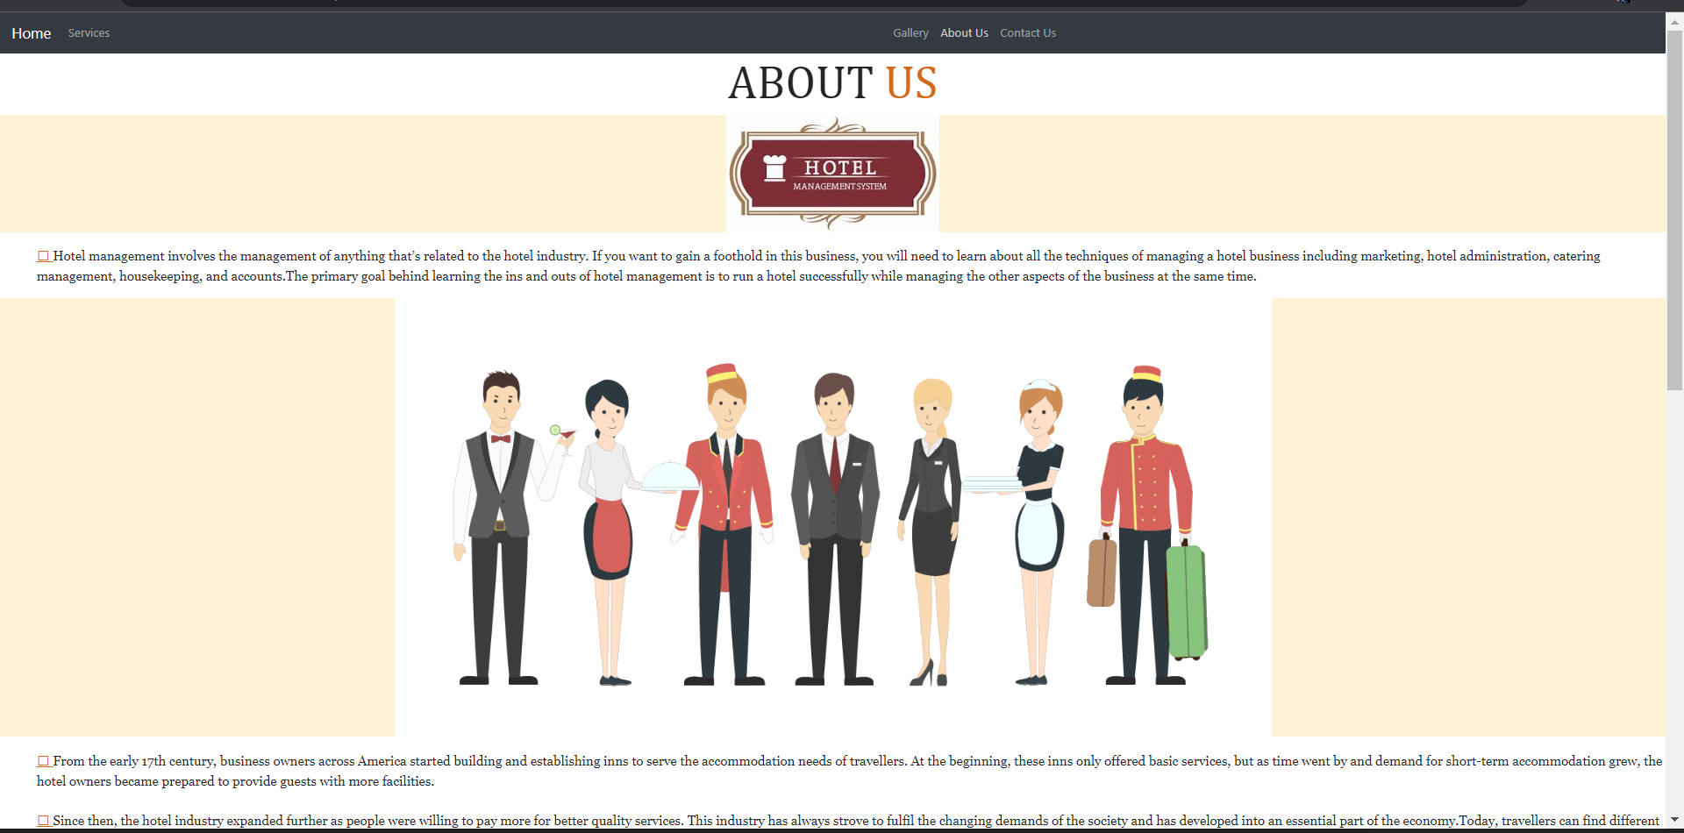
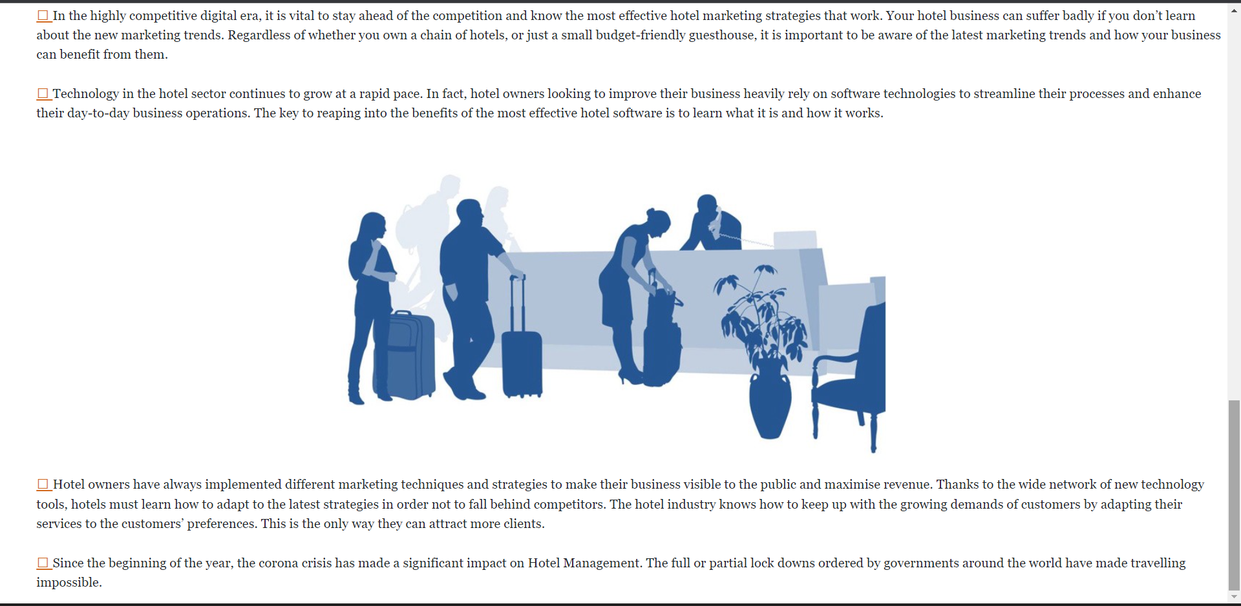
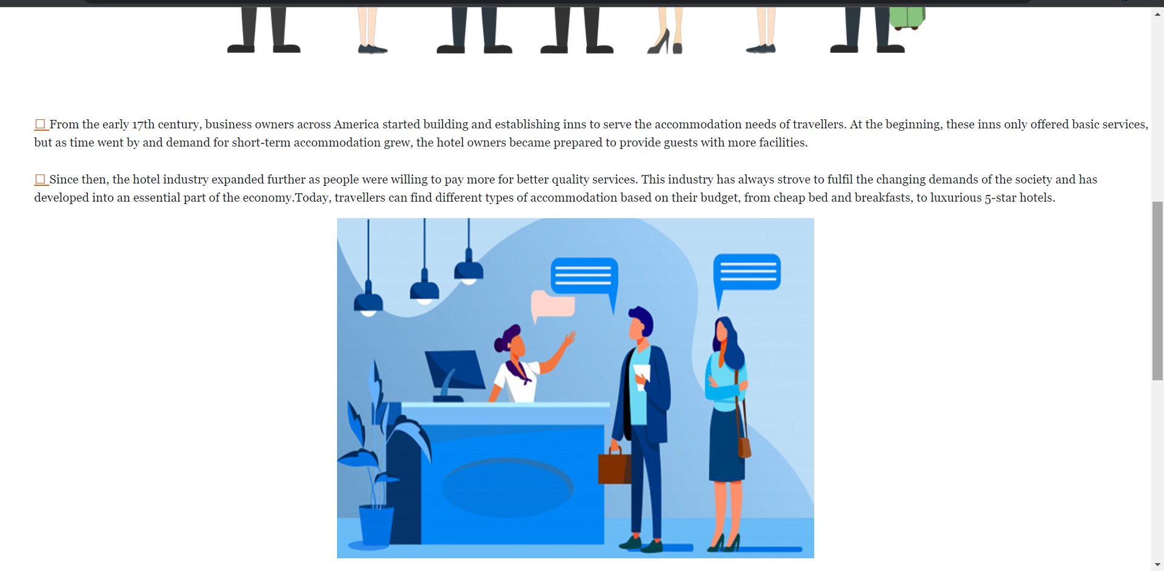
ABOUT US

Slide 21
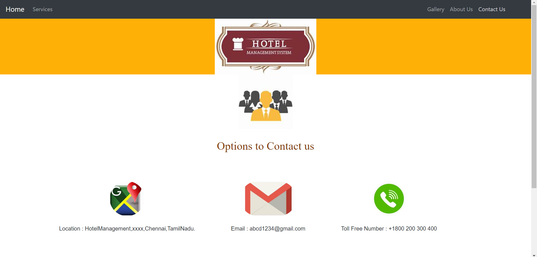

CONTACT US

Slide 22
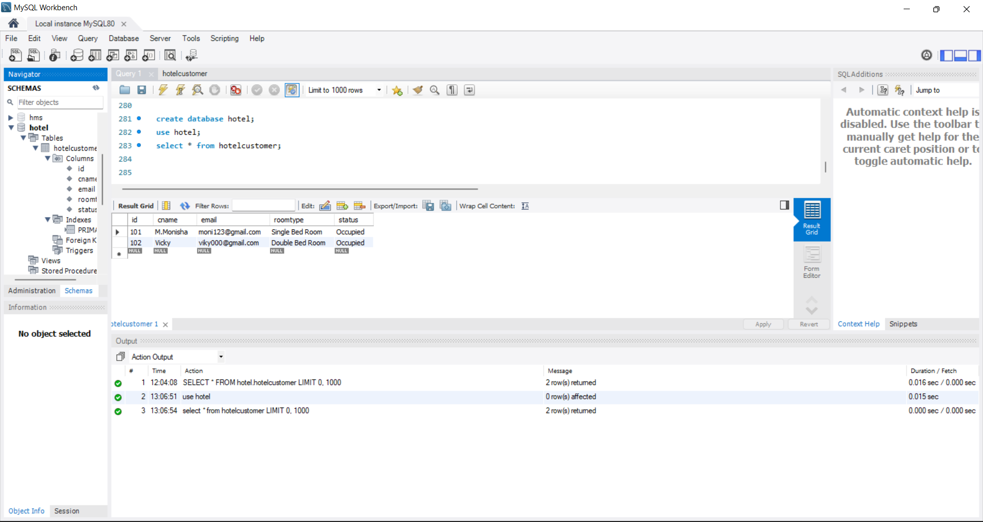
Database Structure
Here we use MySQL Workbench as Database in Backend to computerize the process of Hotel Management.

Slide 23
FEATURES
Implement cancel operation
Implement UPDATE Feature
Implement BOOKING Feature
IMPLEMENT STATUS LIST FEATURE

Slide 24
Advantages & Scopes
It saves organization resources & expenses & time.
Repair development deployment
User support & Reusable
Any hotel will use this framework.
Highly Interactive & Instance Response

Slide 25
Conclusion & Future Scope
Future Scope
Conclusion
This application can be easily implemented under various situation. We can add new features as and when require.
Reusability is possible as & when require in this application. Flexibility in all modules.
This project developed using Angular as Frontend & SpringBoot as Backend and MySQL Workbench as Database in Backend to computerize the process of Hotel Management.

Slide 26
GitHub Link
Source Code on my GitHub repository:
“https://github.com/Moni1311/”

Slide 27
Thank You

